Slide 1
Data Science Internship Project
Sumit Sonar

Slide 2
Dataset Overview:
The dataset contains environmental and atmospheric measurements.
Recorded parameters include CO(GT), PT08.S1(CO), NMHC(GT), C6H6(GT), and more.
Date and time columns provide timestamps for each data entry.
Use Cases:
Air quality research.
Environmental science.
Atmospheric studies.

Slide 3
Column Descriptions:
CO(GT): Carbon monoxide concentration.
PT08.S1(CO): Tin oxide sensor response for CO.
NMHC(GT): Non-methane hydrocarbon concentration.
C6H6(GT): Benzene concentration.
PT08.S2(NMHC): Tin oxide sensor response for NMHC.
NOx(GT): Nitrogen oxides concentration.
PT08.S3(NOx): Tin oxide sensor response for NOx.
NO2(GT): Nitrogen dioxide concentration.
PT08.S4(NO2): Tin oxide sensor response for NO2.
PT08.S5(O3): Tin oxide sensor response for O3.
T: Temperature.
RH: Relative humidity.
AH: Absolute humidity.

Slide 4
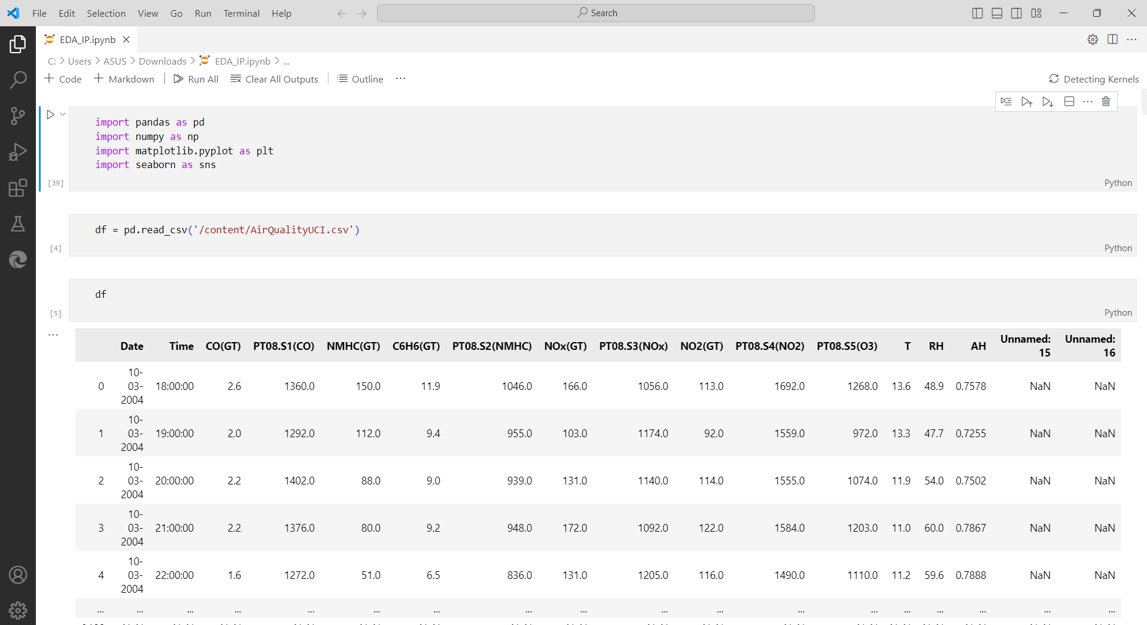
Exploratory Data Analysis
Importing Libraries and dataset
in colab ->

Slide 5
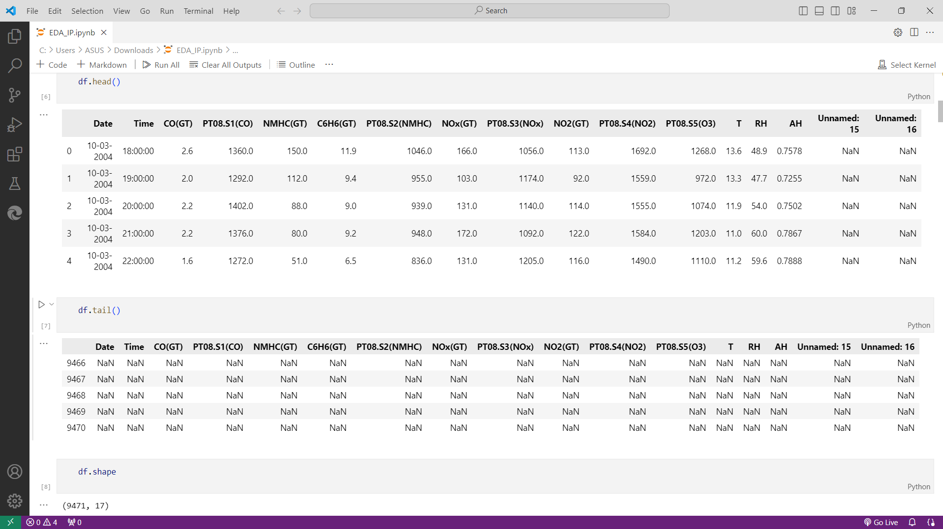
Exploratory Data Analysis
Checking first 5
and last 5 rows ->

Slide 6
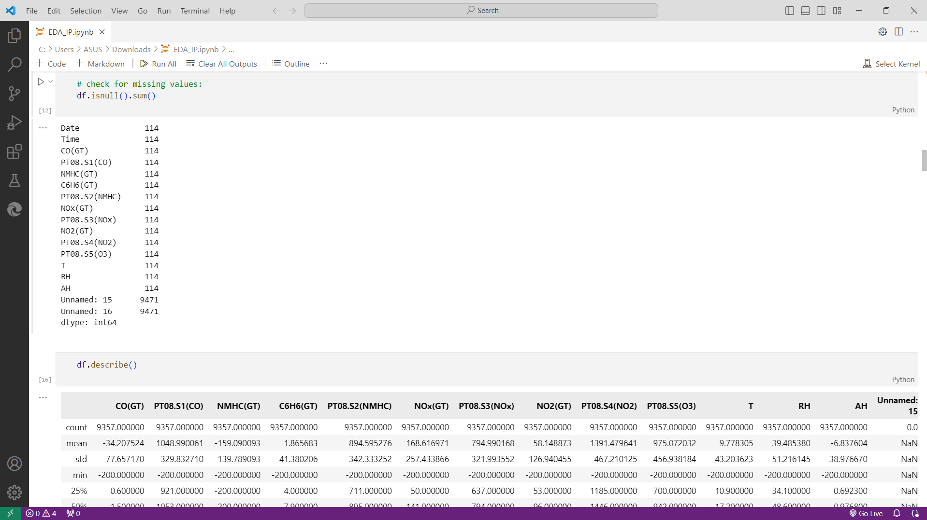
Exploratory Data Analysis

Slide 7
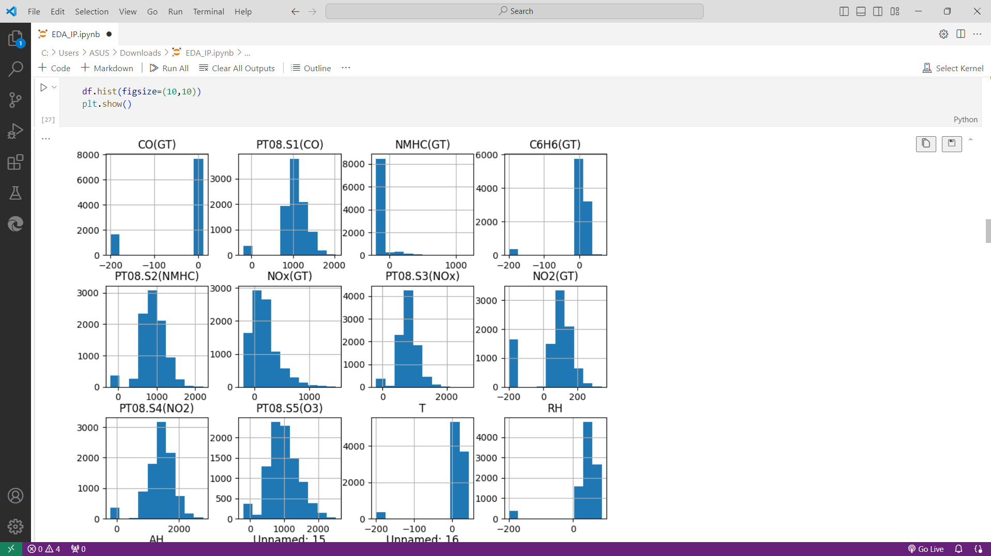
Exploratory Data Analysis

Slide 8
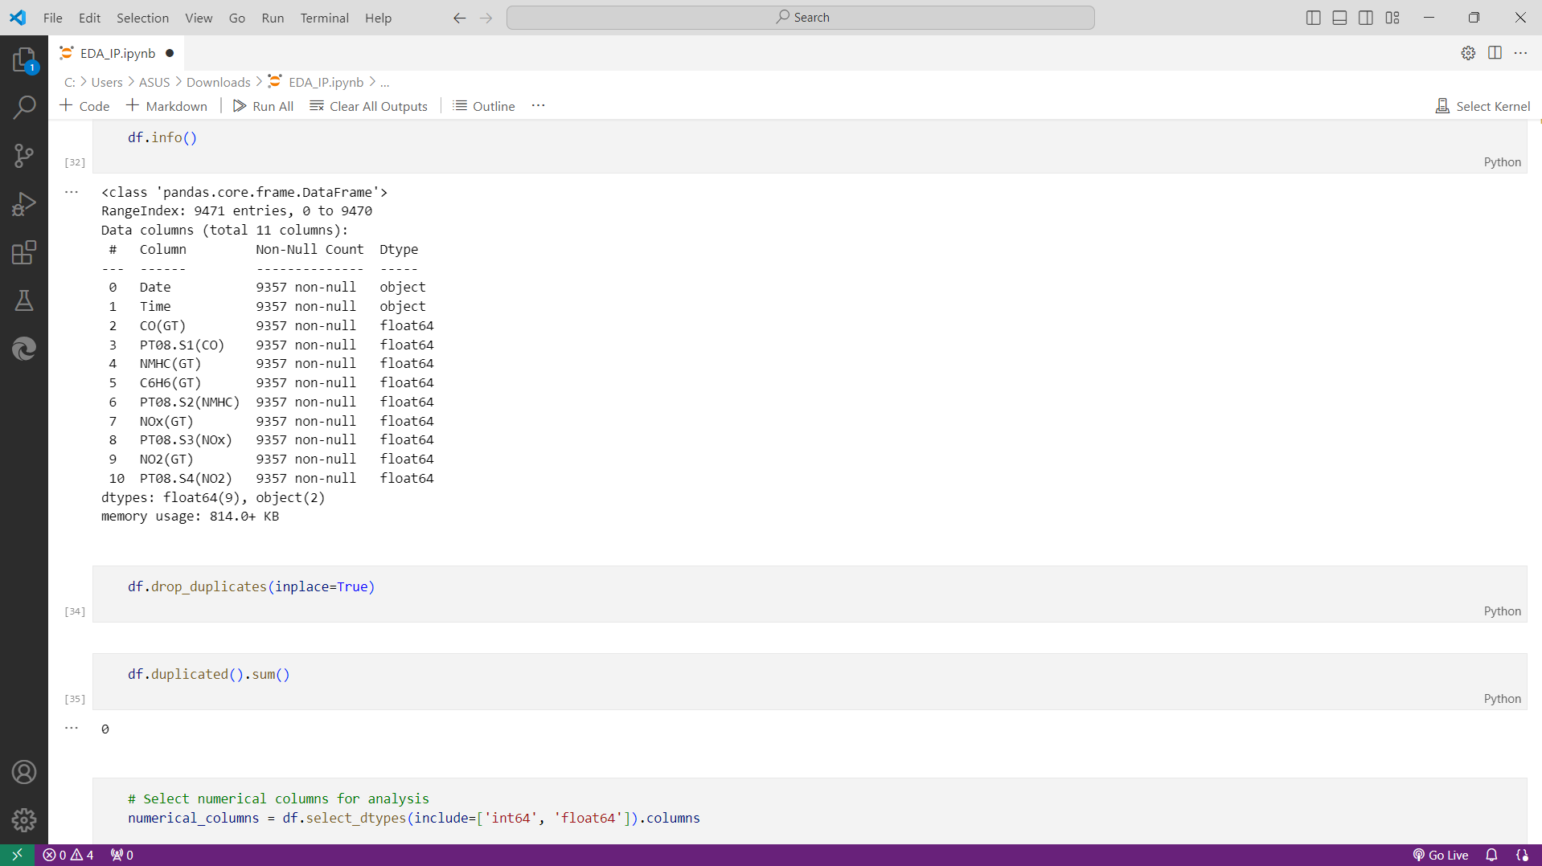
Exploratory Data Analysis
Checking Duplications ->

Slide 9
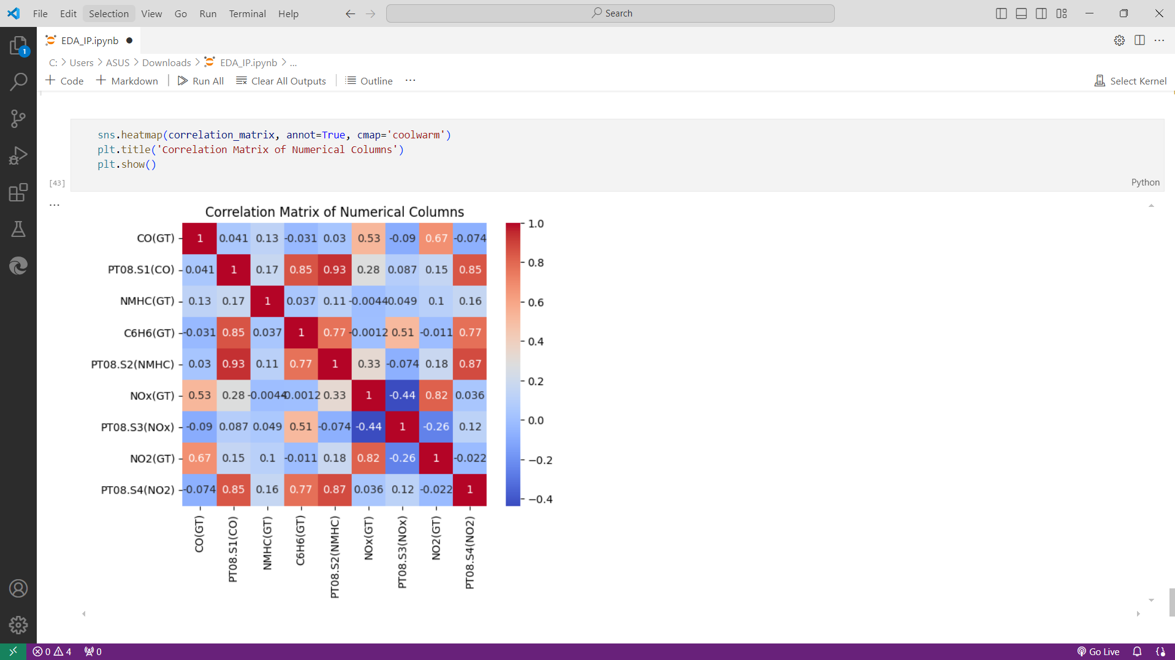
Exploratory Data Analysis

Slide 10
Thank You!!

